Slide 1
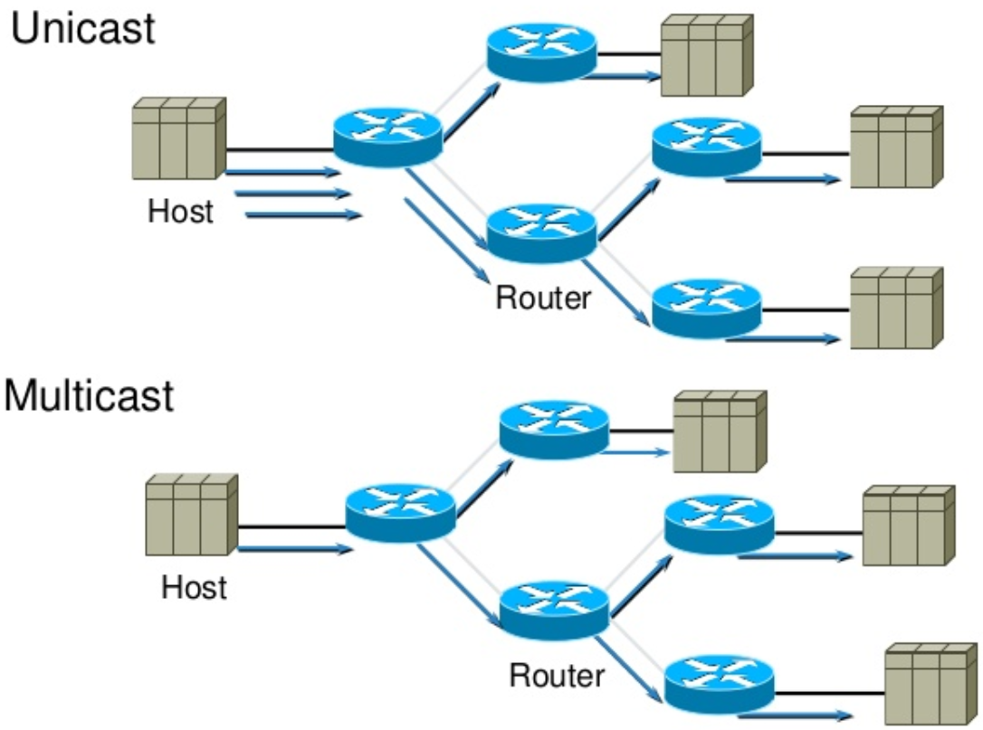
Distance Vector Multicast Routing Protocol (DVMRP)
Multicast routing protocol, RFC1075 (1988).
Used in first internet multicast backbone (MBONE, 1992).
IPv4 address types: unicast, broadcast, multicast.
Not connection-oriented, best-effort delivery (IP).
Not guarenteed to reach all group members.
Hosts are free to join or leave a group at any time.
Sender need to be aware of group members.
Multicast conserves bandwidth by forcing network to do packet replication.
Radio / VIdeo broadcasts, Video conferencing, Distance learning
Shared applications, Multiplayer gaming, Chat rooms
Advertisements, Stocks, Distributed databases

Slide 2
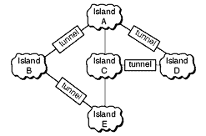
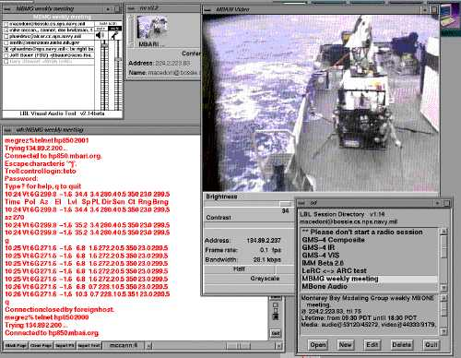
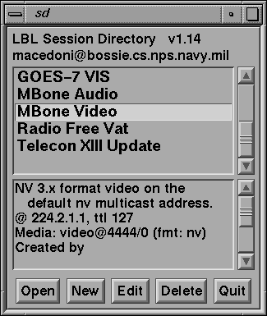
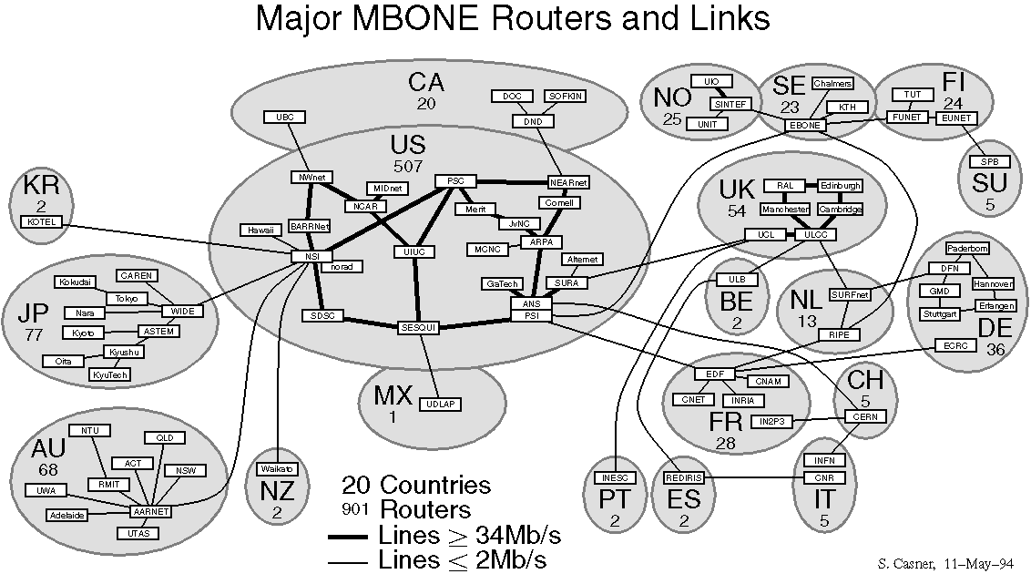
Multicast Backbone (MBONE)
Interconnected subnetworks and multicast routers.
Created by Jacobson, Deering, Casner (1992).
Uses tunnels for connecting through unicast routers.
Uses DVMRP, MOSPF for routing along with IGMP.
IP Address: 224.2.0.0 (audio 64kbps, video 120 kbps)
IETF meetings, US House & Senate sessions
NASA Space shuttle missions, Satellite weather photos
1992: 40 subnets in 4 countries
1993: Live band performance by Severe Tire Damage
1995: M-bone links in Russia, Antarctica
1996: 2800 subnets in 25 countries
2008: Virtual video conferencing system in use

Slide 3
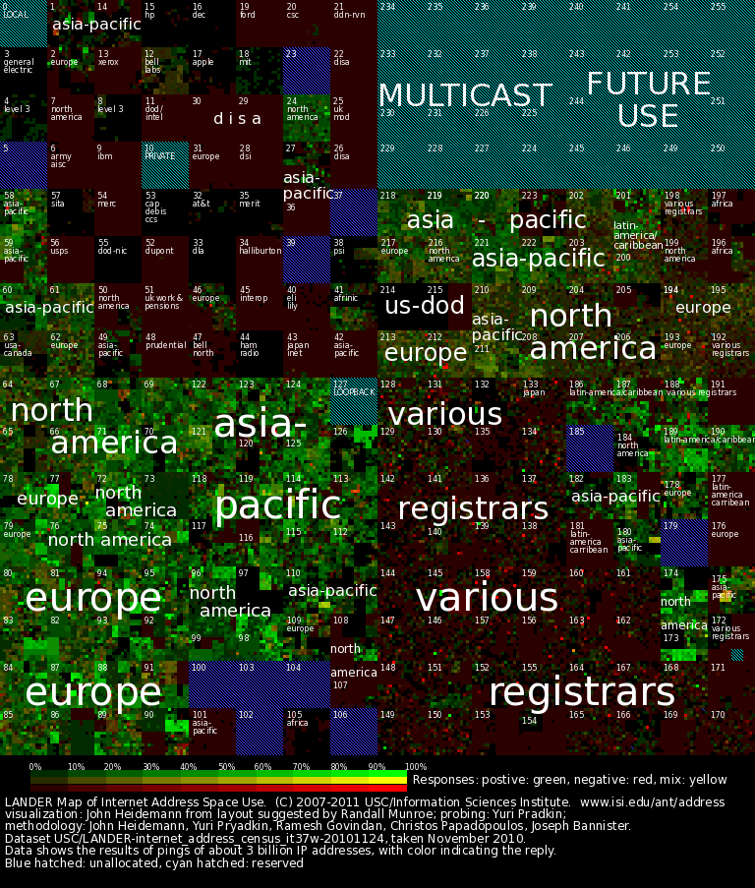
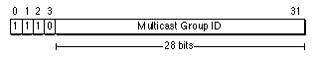
Multicast Addressing
Class D IP addresses are used for multicast.
Start with "1110" followed by 28-bit group ID.
Fixed vs Transient multicast IP (logical address).
224.0.0.0: Reserved Class D
224.0.0.1: All multicast devices
224.0.0.2: All multicast routers
224.0.0.4: All DVMRP routers
224.0.0.5: All OSPF routers
224.0.1.11: IETF-1-Audio
224.0.1.12: IETF-1-Video
224.0.0.255: Last reserved for routing
239.0.0.0: Site-local applications
239.255.255.255: Last Class D

Slide 4
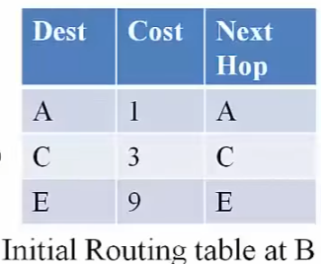
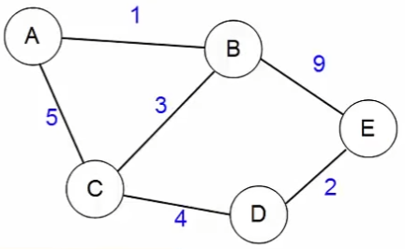
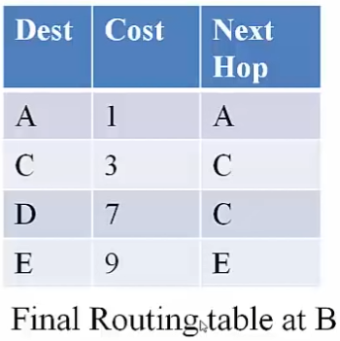
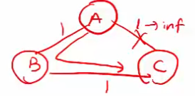
Distance Vector Routing (eg. RIP)
Find the least cost path between 2 nodes.
Also called Bellman-Ford algorithm (distributed).
Each node maintains a routing table.
Originally used in ARPAnet, RIP (now used rarely).
Initial: Distance (cost) to its neighbours is known.
Goal: Distance to all neighbours & next-hop known.
Routing table info is shared with neighbours (except next-hop).
On receiving message, routing table updated with min-cost path.
After N rounds, N+1 hop paths become known.
Triggered update: link / node failure or cost change
Periodic update: Still alive, update DV if some route becomes invalid
Periodic update helps when a route becomes invalid
Bellman-Ford distance update equation

Slide 5
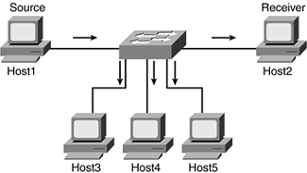
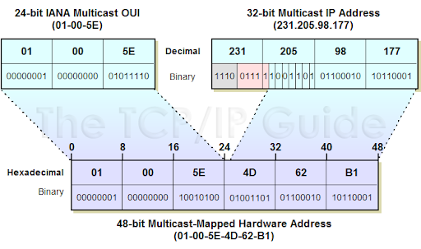
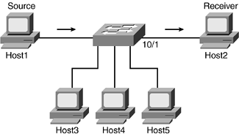
Multicast Flooding
Router / Host sends packet on all interfaces.
If router has been seen packet before, its discarded.
Used on local network for multicast communication.
Filtering can be done with Multicast MAC address.
Each Host Receives the Multicast Stream
Multicast Stream is filtered by Switch through Multicast MAC address

Slide 6
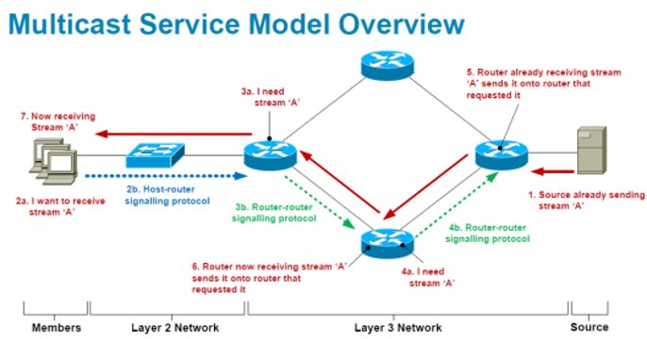
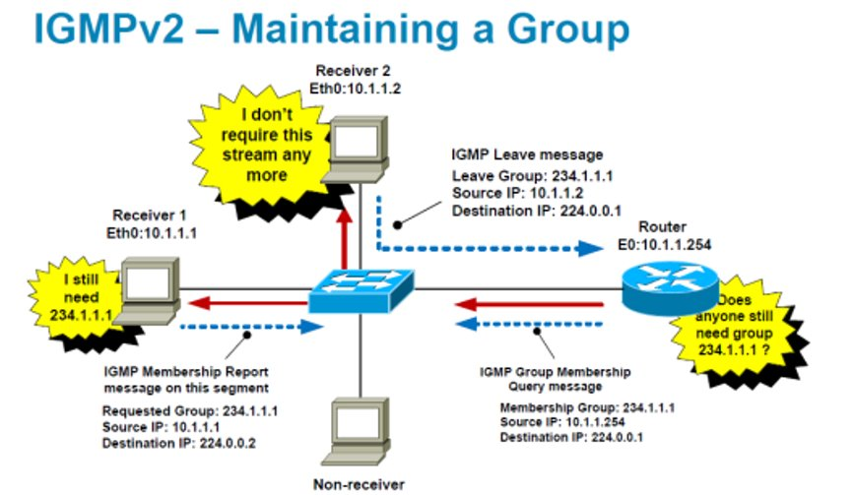
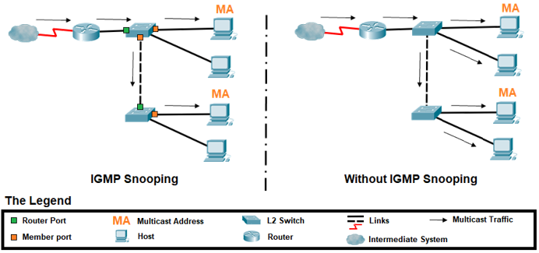
Internet Group Management Protocol (IGMP)
Hosts tell router about group membership (RFC 1112).
Router uses this to help route multicast packets.
Filtering can be done with IGMP snooping by switch.
Report: Host says to router, "I want to receive multicast data for X.X.X.X".
Query: Router asks hosts, "Is anone still interested in data for X.X.X.X"?
Report is sent to address X.X.X.X, and received by other members & router.

Slide 7
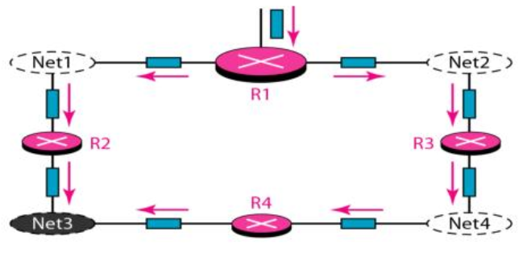
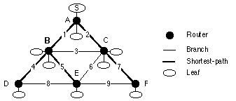
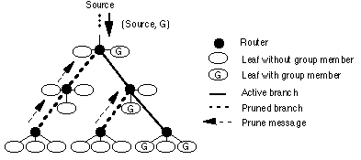
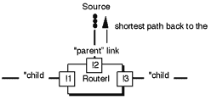
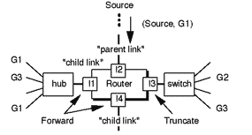
Reverse Path Multicasting (RPM)
Net3 recieves 2 packets
Forward packet that arrives on shortest path to source.
Router discards packet if it arrives on any other interface.
Delivery tree is truncated if leaf subnet has no members.
Prune message is sent if all child links are truncated.
Opt: Forward only if on downstream router's shortest path.
Duplicates are possible since shortest path is source-based.
RPB
TRPB
RPM
Opt. Reverse Path Broadcasting (RPB)
RPB
Reverse Path Broadcasting (RPB)
Truncated Reverse Path Broadcasting (TRPB)
Reverse Path Multicasting (RPM)

Slide 8
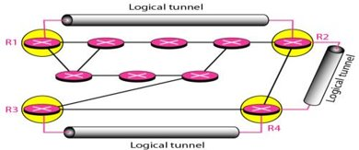
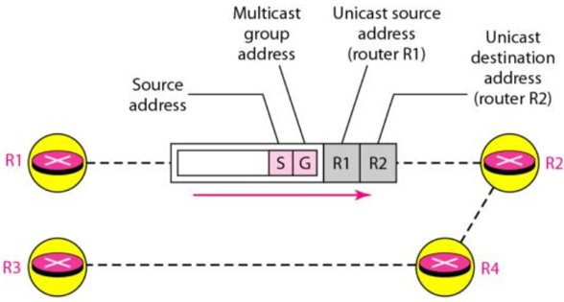
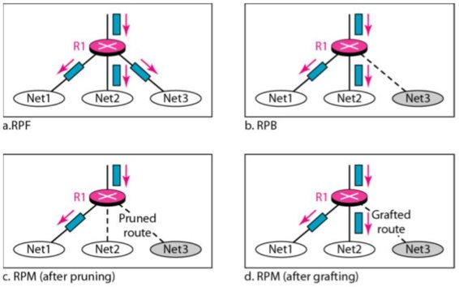
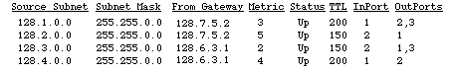
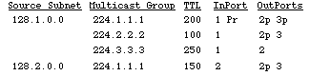
DVMRP
It is a distance vector multicast protocol, like RIP.
Suitable for use within autonomous system.
Tunnels are used between non-multicast routers.
Routers need to run a unicast protocol too.
Reverse path multicasting (RPM) used between routers.
Intially (S,G) packet is broadcasted using TRPB.
IGMP is used to find group members in subnets.
Routers send prune message to parent if subnet has no group member.
Routers send graft message to parent if subnet has new group member.
DVMRP, MOSPF, PIM: within Autonomous System
MBGP: between Autonomous Systems
DVMRP Routing table
DVMRP Forwarding table

Slide 9
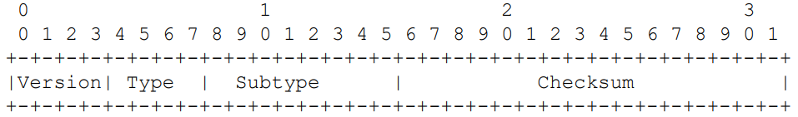
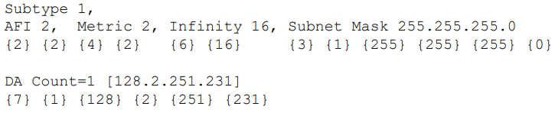
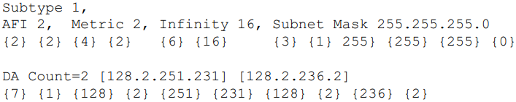
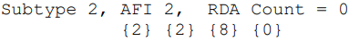
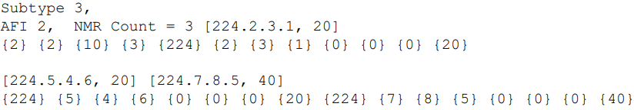
DVMRP Datagrams
DVMRP header
DVMRP uses IGMP to exchange routing datagrams (type 3).
Message is a stream of tagged data (key=value, … max 512B).
Routers provide periodic and triggered updates.
Messages sent to multicast address 224.0.0.4 (TTL=1).
Request: request route to sources
Response: provide route to sources
Non-membership report: prune path for T seconds (no member)
Non-membership cancellation: graft path (new member)
NULL, Flags0, Infinity, Metric
Address Family Indicator (AFI), Subnet mask
Destination Address (DA)
Requested Destination Address (RDA)
Non Membership Report (NMR)
Non Membership Report Cancel (NMR Cancel)
Response of route for 128.2.251.231 with metric 2, INF=16, SM=255.255.255.0
Subtypes
Response of route for 128.2.251.231 & 128.2.236.2 with metric 2, INF=16, SM=255.255.255.0
Request all routes (to source).
Commands
NMR for groups 224.2.3.1 & 224.5.4.6 (20s), 224.7.8.5 (40s)

Slide 10
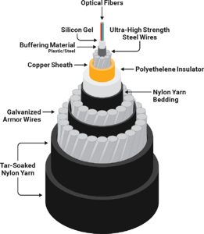
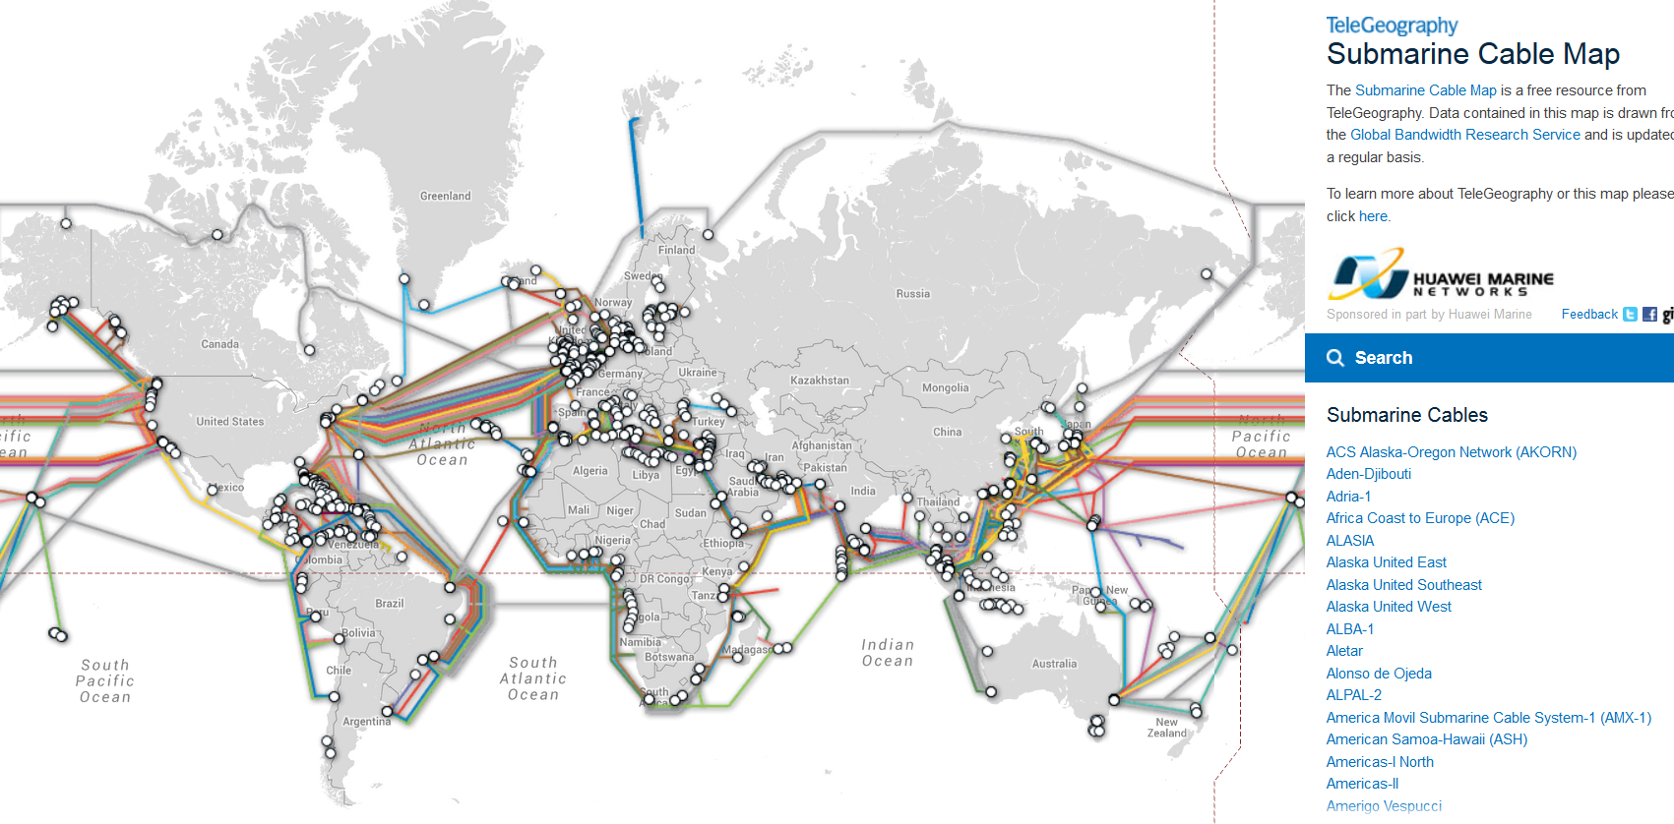
406 Submarine Cables
Minimum design life of 25 years.
Satellites account for 0.37% of all U.S. international capacity.
The new MAREA cable is capable of carrying 208 Tbps.
Google, Facebook, Microsoft, and Amazon are major investors in new cable.
Total 1.2 million km (2020)

Slide 11
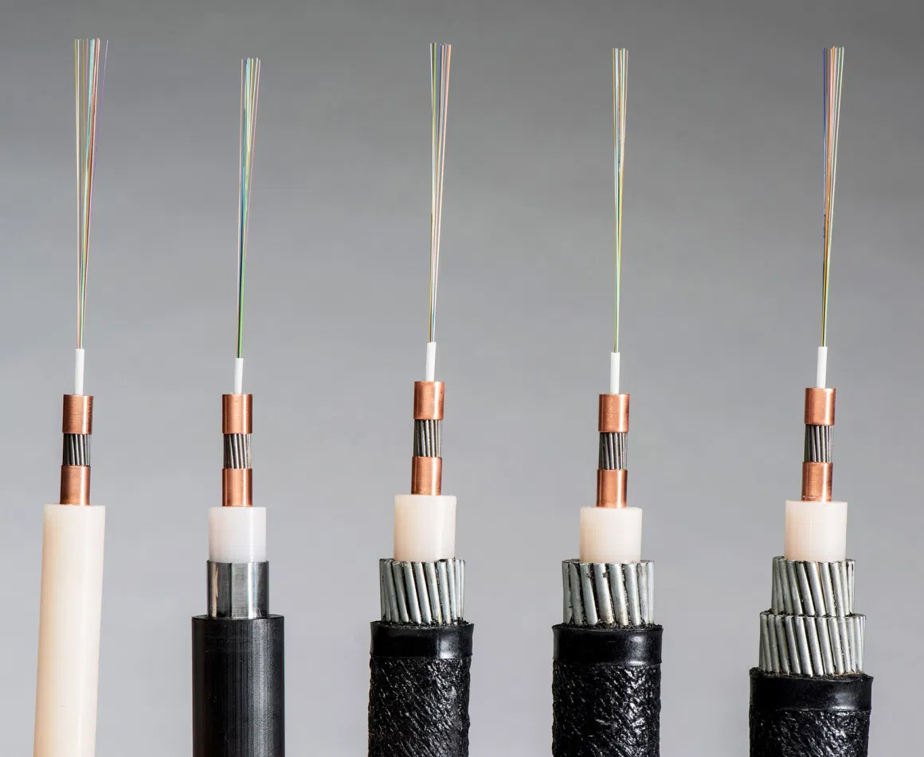
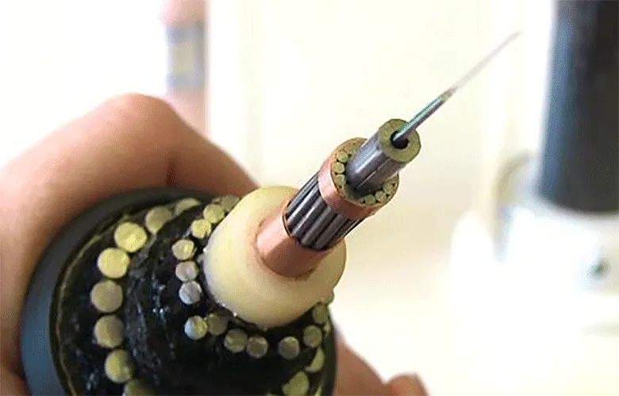
Manufacturing & Deployment
Japanese NEC developed 20 fiber pair (40) cable. (2020)
Google announced a cable with 24 pairs of optical fibers.
Bandwidth of 12-pair Dunant is declared at 250 Tbps.
DWDM allows 100 wavelengths over a single fiber.
Largest manufacturers:
Alcatel Submarine Networks (ASN) (France)
TE SubCom (USA)
Nippon Electric Company (NEC) (Japan)
Prysmian (Italy)
Nexans (France)
Hengtong (China)
Zhongtian (China)
Lightweight (LW)
> 2000m
Light-Wire Armored (LWA)
Buried
Double Armored (DA)
Beach joint-400m
Special Application (SPA)
900-2000m
Single Armored (SA)
400-900m
Light
Subcom Fiber Optic Cable Kit.

Slide 12
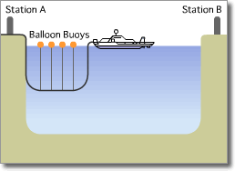
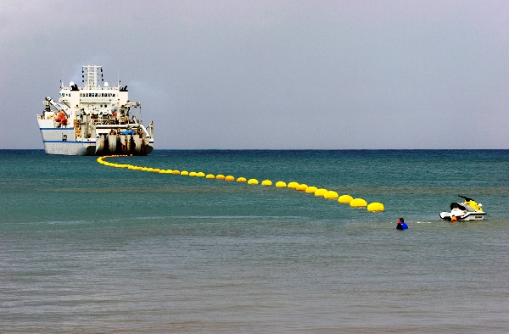
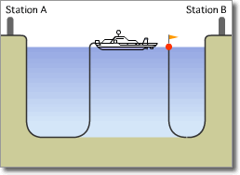
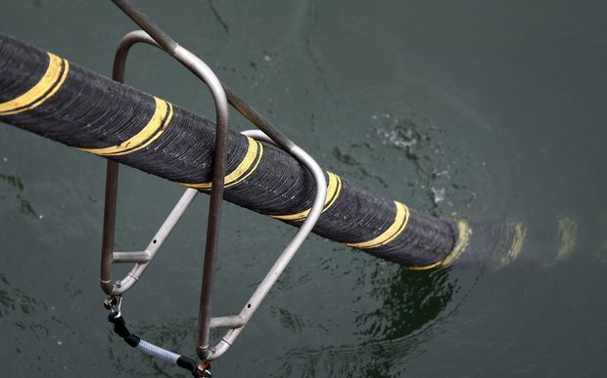
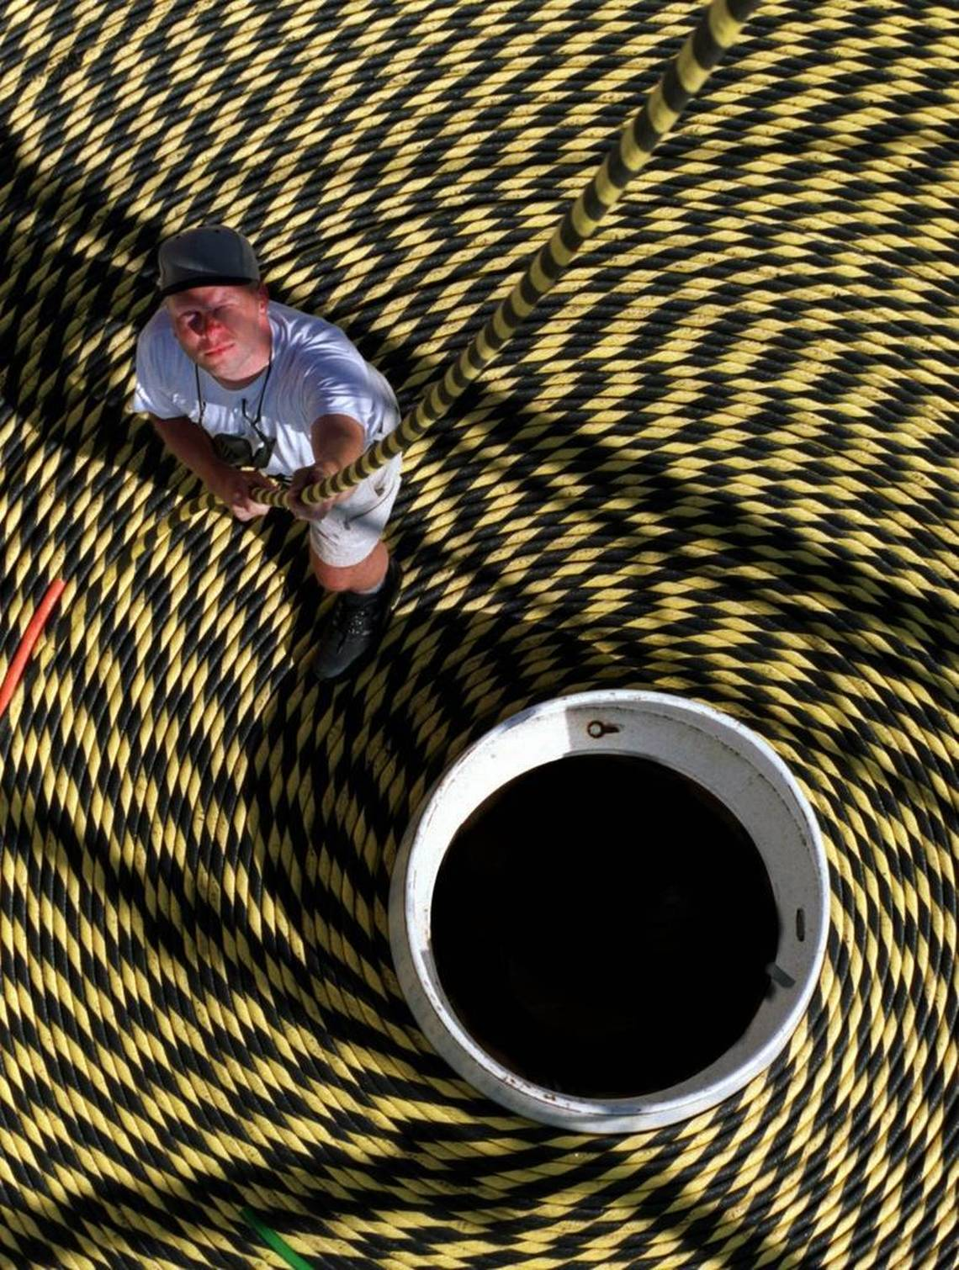
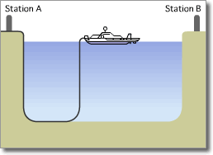
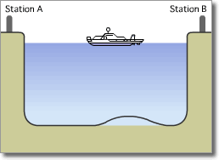
1. Extending
3. Splicing with other side
2. Dropping
4. Dropping

Slide 13
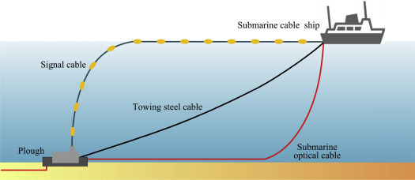
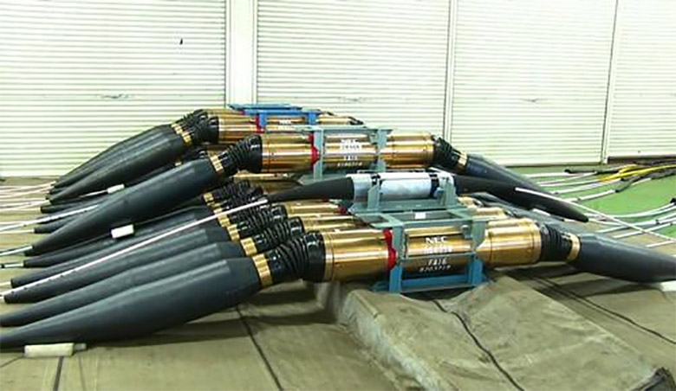
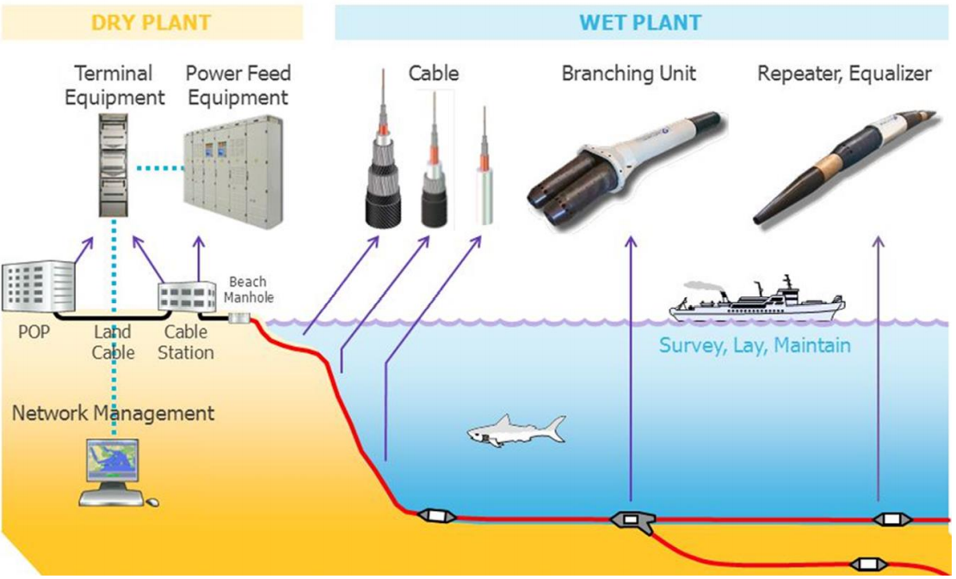
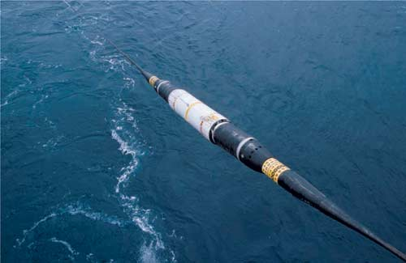
Hydro Jet
Cable laying
NEC repeaters with four signal amplifiers are located at the OCC factory in Japan.
Network architecture
Alcatel Submarine Networks Optical Repeater

Slide 14
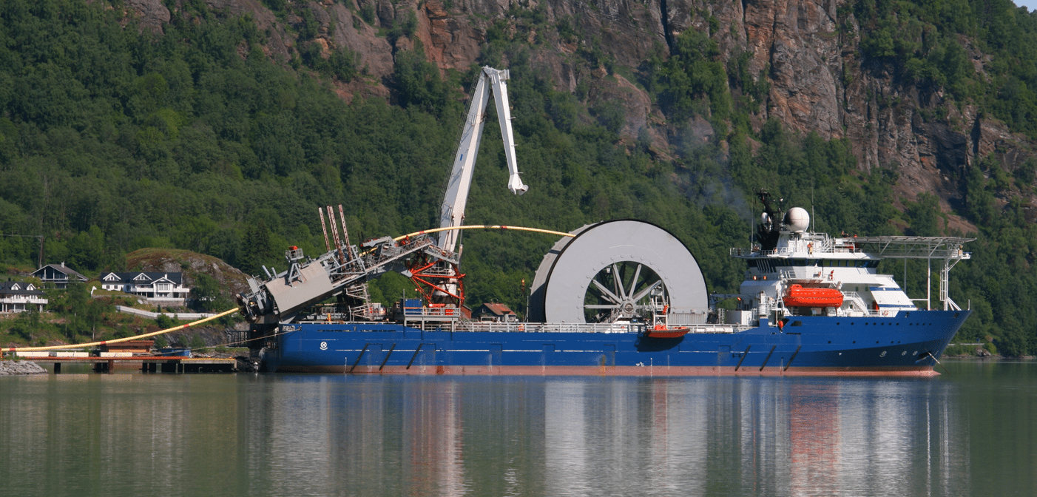
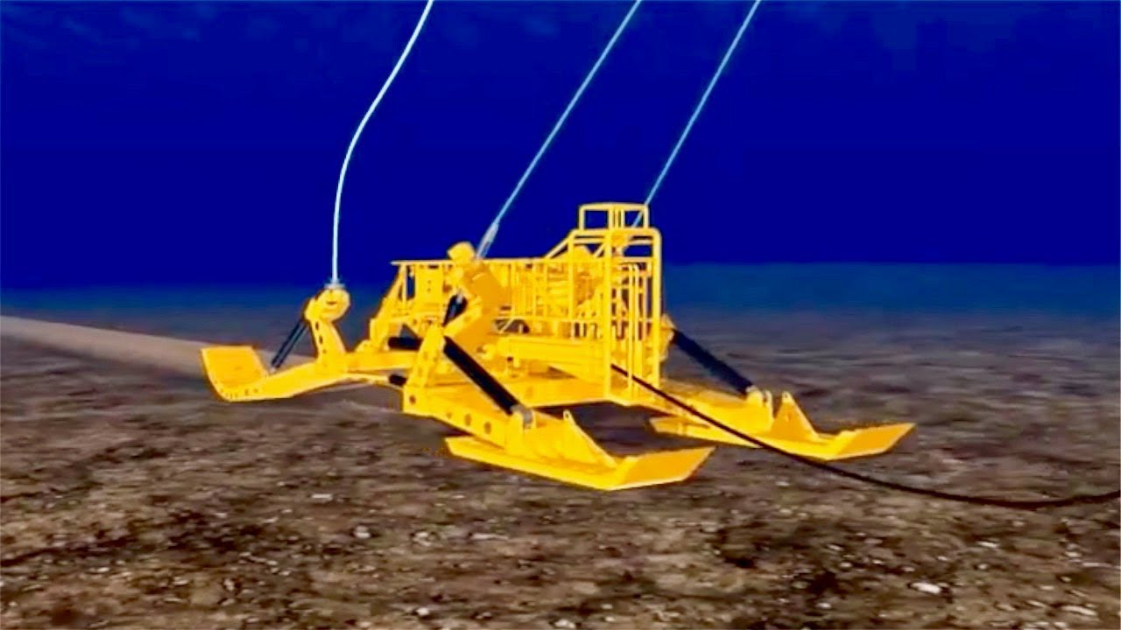
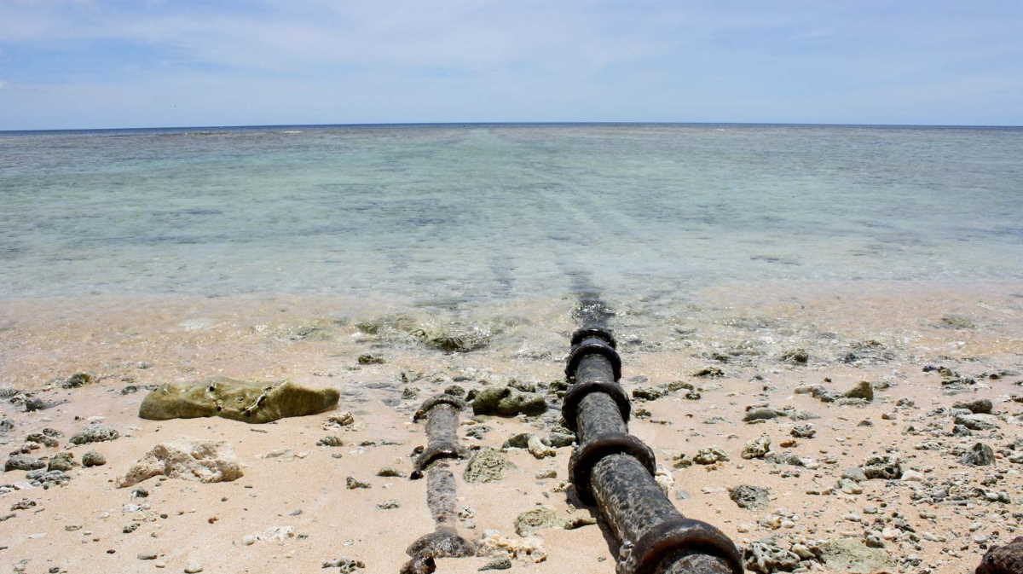




Sea plow for Cable burial
Installation ship
Polynesia submarine cable
Survey ship
Maintenance ship

Slide 15


FEA
SEA-ME-WE 3
The FLAG Europe Asia (Fiber-optic Link Around Globe).
Length: 28,000km, Capacity: 80Gbps (1997)
Operators: Global Cloud Xchange (RCOM) (1)
CLS: Chennai (Tata Comm.) (18)
The South-East Asia Middle East Western Europe 3.
Length: 39,000km, Capacity: 100G (1999)
Operators: BSNL (92)
CLS: Mumbai (Tata Comm.), Kochi (Tata Comm.) (39)

Slide 16


I2ICN
SAFE
The i2 Cable Network.
Length: 3,100km, Capacity: 8.4Tbps (2002)
Operators: Bharti Airtel (2)
CLS: Chennai (Airtel) (2)
The South Africa Far East.
Length: 13,500km, Capacity: 130Gbps (2002)
Operators: Tata Comm. (30)
CLS: Cochin (Tata Comm.) (6)

Slide 17


TIC
SEA-ME-WE 4
The Tata Indicom Cable.
Length: 3,175km, Capacity: 5.1Tbps (2004)
Operators: Tata Comm. (1)
CLS: Chennai (Tata Comm.) (2)
The South East Asia-Middle East-West Europe 4.
Length: 18,800km (4), Capacity: 4.6Tbps (2005)
Operators: Tata Comm., Bharti Infotel (16)
CLS: Mumbai (Airtel), Chennai (Airtel) (17)

Slide 18


BLCS
FALCON
The Bharat Lanka Cable System.
Length: 320km, Capacity: 1Tbps (2006)
Operators: BSNL (2)
CLS: Tuticorin (Reliance) (2)
The FLAG Alcatel-Lucent Optical Network.
Length: 11,859km, Capacity: 2.56Tbps (2006)
Operators: Global Cloud eXchange (16)
CLS: Mumbai (Reliance) (17)

Slide 19


SEACOM
IMEWE
The SEACOM Cable.
Length: 17,000km, Capacity: 1.5Tbps (2009)
Operators: (5)
CLS: Mumbai (Tata Comm. / VSNL) (9)
The India Middle-East Western-Europe.
Length: 12,091km, Capacity: 5.6Tbps (2010)
Operators: Bharti Airtel, Tata Comm. (9)
CLS: Mumbai (Tata Comm.) (10)

Slide 20


EIG
TGN-EA
The Europe India Gateway.
Length: 15,000km (4), Capacity: 3.8Tbps (2011)
Operators: Bharti Airtel, BSNL (16)
CLS: Mumbai (Airtel) (12)
The Tata Global Network-Eurasia.
Length: 9,280km, Capacity: 1.28Tbps (2012)
Operators: Tata Comm. (1) (RTD: 92ms)
CLS: Mumbai (Tata Comm. / VSNL) (5)

Slide 21


GIBY
MENA
The Gulf Bridge International.
Length: ?km, Capacity: 5.6Tbps (2012)
Operators: Bharti Airtel (?)
CLS: Mumbai (Sify Tech.) (10)
The Middle East North Africa.
Length: 8,800km, Capacity: 5.8Tbps (2014)
Operators: Bharti Airtel (?)
CLS: Mumbai (Sify Tech.) (7)

Slide 22


CANI
The Chennai - Andaman and Nicobar Islands.
Length: 2300km, Capacity: 6.4Tbps x 4 (Aug 2020)
Operators: BSNL (?), Cost: 1224 Cr.
CLS: (9), Handled by: NEC Corp. (Japan)

Slide 23

Cable Landing Stations in India
GCX: Reliance Globalcom B.V.
IOX: India Ocean eXchange

Slide 24


Slide 25

Landing of an Italy-USA cable (4,704 nautical miles long), on the Rockoway beach, New-York, January 1925.

Slide 26



Request For Comments
RFCs cover many aspects of computer networking, including protocols, procedures, programs, and concepts, as well as meeting notes, opinions, and sometimes humor.
RFCs area associated with an active IETF Working Group.
Published RFCs never change. Technical & Editorial Errata are provided.
Started 7 Apr 1969, by Steve Crocker
RFC 1: Host Software
RFC 2555: 30 Years of RFCs
https://ietf.org/standards/rfcs/
www.arkko.com/tools/rfcstats/

Slide 27


IETF Working Groups
Applications & Real-Time area (29)
General area (2)
Internet area (17)
Operations & Management area (14)
Routing area (24)
Secutiry area (25)
Transport area (11)
https://ietf.org/standards/rfcs/
https://datatracker.ietf.org/wg/
www.arkko.com/tools/rfcstats/

Slide 28

April RFCs
IPoAC: IP over Avian Carriers
RFC527: ARPAWOCKY (1973)
Beware the ARPANET, my son;
The bits that byte, the heads that scratch;
Beware the NCP, and shun
the frumious system patch,
RFC7511: Scenic Routing for IPv6 (2015)
This document specifies a new routing scheme for the current version of the Internet Protocol version 6 (IPv6) in the spirit of "Green IT", whereby packets will be routed to get as much fresh-air time as possible.
RFC2549: IP over Avian Carriers with Quality of Service (1999)
The following quality of service levels are available: Concorde, First, Business, and Coach. Concorde class offers expedited data delivery. One major benefit to using Avian Carriers is that this is the only networking technology that earns frequent flyer miles, plus the Concorde and First classes of service earn 50% bonus miles per packet. Ostriches are an alternate carrier that have much greater bulk transfer capability but provide slower delivery, and require the use of bridges between domains.
RFC 3514 The Security Flag in the IPv4 Header 1 April 2003 The bit field is laid out as follows: 0 +-+ |E| +-+ Currently-assigned values are defined as follows: 0x0 If the bit is set to 0, the packet has no evil intent. Hosts, network elements, etc., SHOULD assume that the packet is harmless, and SHOULD NOT take any defensive measures. (We note that this part of the spec is already implemented by many common desktop operating systems.) 0x1 If the bit is set to 1, the packet has evil intent. Secure systems SHOULD try to defend themselves against such packets. Insecure systems MAY chose to crash, be penetrated, etc.

Slide 29


Regional Internet Registries (RIRs)
RFC2050 (1996)
A Regional Internet Registry (RIR) manages the allocation and registration of Internet number resources in a particular region of the world and maintains a unique registry of all IP numbers issued.
(1996)
(InterNIC, 1996)
(1996)
(2005)
(2002)
Each RIR received its last /8 IPv4 address block from IANA on 3 February 2011
Coordinating body for 5 RIRs

Slide 30


National Internet Registries (RIRs)

Slide 31


Slide 32


Slide 34


Slide 35





M: 0 ASN: 0 IPv4: 405 IPv6: 0 S: 1
M: 27 ASN: 1 IPv4: 513 IPv6: 0 S: 2
M: 55 ASN: 47 IPv4: 993 IPv6: 0 S: 3
M: 114 ASN: 63 IPv4: 1050 IPv6: 0 S: 5

Slide 36




M: 200 ASN: 98 IPv4: 274 IPv6: 0 S: 5
M: 249 ASN: 108 IPv4: 166 IPv6: 0 S: 6
M: 396 ASN: 128 IPv4: 232 IPv6: 5 S: 12
M: 602 ASN: 230 IPv4: 353 IPv6: 14 S: 23

Slide 37




M: 699 ASN: 220 IPv4: 360 IPv6: 25 S: 31
M: 767 ASN: 203 IPv4: 301 IPv6: 86 S: 33
M: 879 ASN: 198 IPv4: 422 IPv6: 50 S: 40
M: 978 ASN: 186 IPv4: 568 IPv6: 57 S: 44

Slide 38




M: 1157 ASN: 245 IPv4: 705 IPv6: 51 S: 46
M: 1362 ASN: 298 IPv4: 864 IPv6: 42 S: 46
M: 1584 ASN: 308 IPv4: 917 IPv6: 63 S: 57
M: 1855 ASN: 418 IPv4: 984 IPv6: 160 S: 62

Slide 39




M: 2170 ASN: 436 IPv4: 1065 IPv6: 185 S: 63
M: 2521 ASN: 505 IPv4: 1358 IPv6: 643 S: 65
M: 2947 ASN: 495 IPv4: 1475 IPv6: 620 S: 70
M: 3534 ASN: 581 IPv4: 1075 IPv6: 562 S: 71
Each RIR received its last /8 IPv4 address block from IANA on 3 February 2011

Slide 40




M: 3779 ASN: 306 IPv4: 744 IPv6: 255 S: 68
M: 4051 ASN: 646 IPv4: 3914 IPv6: 484 S: 70
M: 5268 ASN: 881 IPv4: 4498 IPv6: 785 S: 76
M: 5994 ASN: 881 IPv4: 4498 IPv6: 785 S: 75

Slide 41



M: 6557 ASN: 1226 IPv4: 2235 IPv6: 1377 S: 77
M: 7162 ASN: 912 IPv4: 2199 IPv6: 1430 S: 80
M: 7776 ASN: 1560 IPv4: 2027 IPv6: 1472 S: 77
IPv6 adoption increased, with the proportion of Members holding IPv6 resources reaching 61% and total IPv6 capability reaching 22%

